Slide 1

ADDIDAS SALES REPORT
Data Analytics-Tableau Project
Namitha K

Slide 2
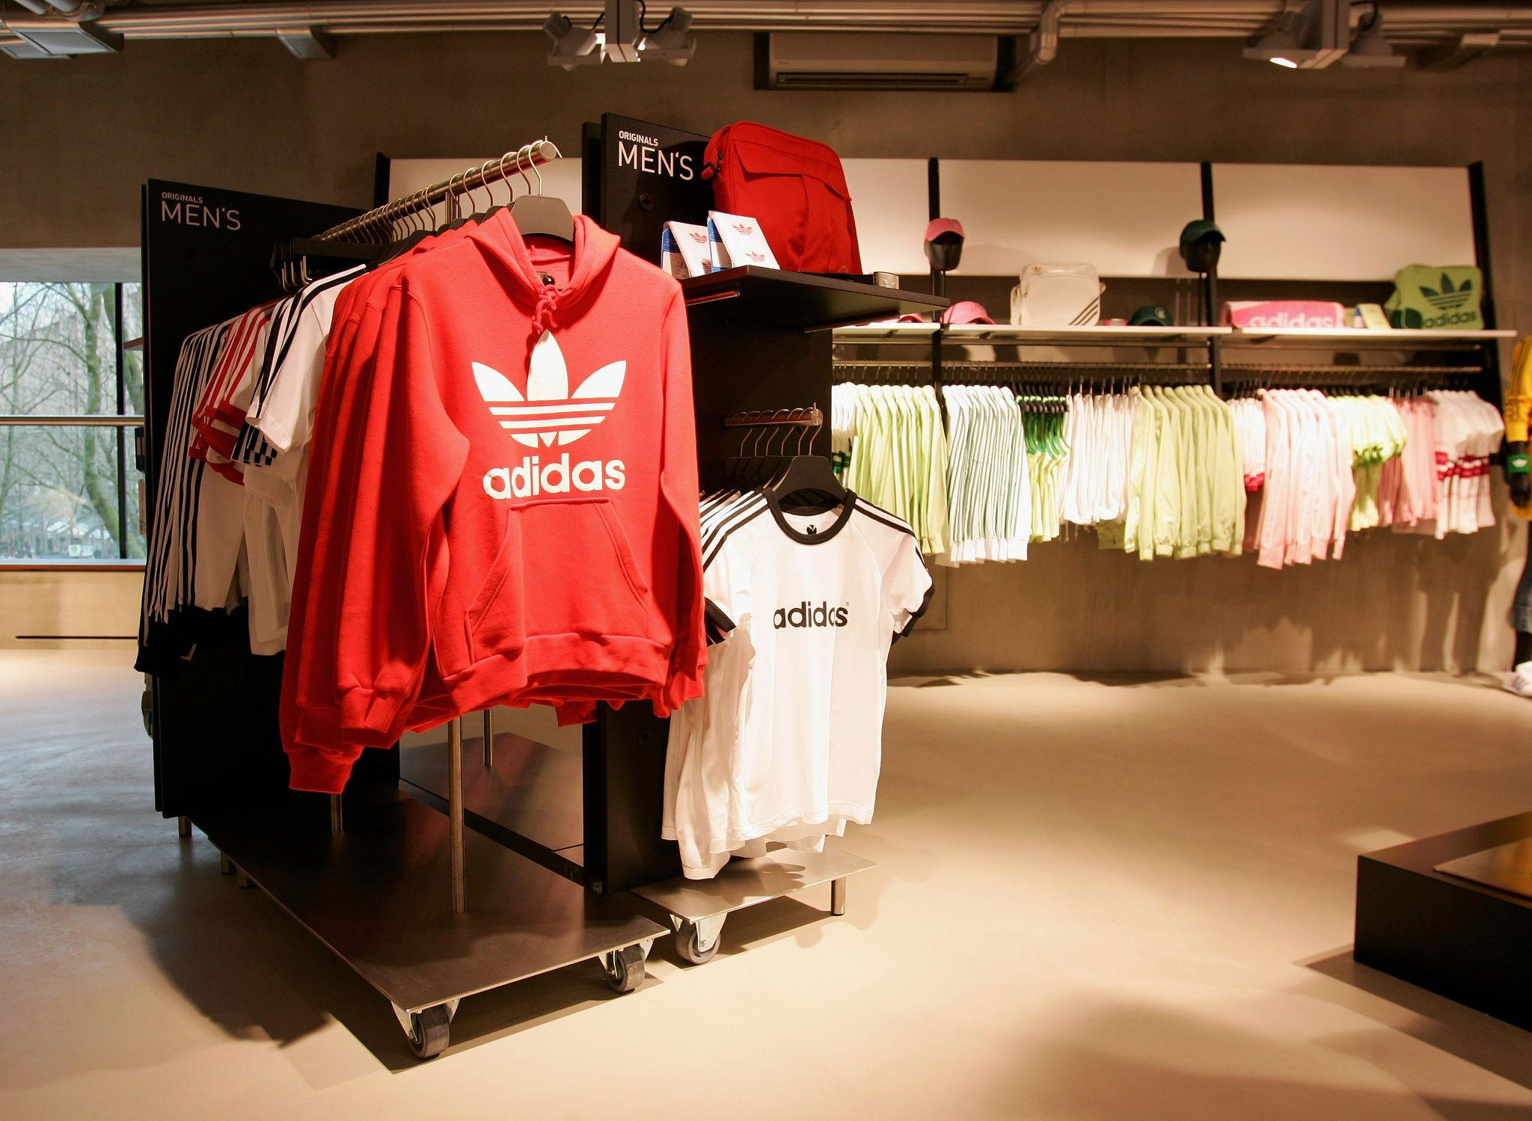
INTRODUCTION
Sales data analysis plays a crucial role in understanding business performance and customer demand.
Adidas, as a global sportswear brand, generates large volumes of sales data across regions and sales channels.
This project focuses on analyzing Adidas sales data to uncover trends, profitability, and regional performance.
Tableau is used to convert raw sales data into meaningful visual insights.

Slide 3

PROBLEM STATEMENT
Raw sales data alone does not clearly indicate business performance.
It is difficult to identify top-performing regions, products, and sales methods without visualization.
There is a need for an interactive dashboard to analyze sales trends and profitability effectively.

Slide 4

OBJECTIVES
To analyze overall Adidas sales and operating profit
To identify high-performing regions and retailers
To study sales trends over timeTo compare different sales methods
To build an interactive Tableau dashboard for decision-making

Slide 5

DATASET OVERVIEW
The dataset contains the following key columns:
Date
Product
Region
Retailer
Sales Method
Price per Unit
Units Sold
Total Sales
Operating Profit
Operating Margin

Slide 6
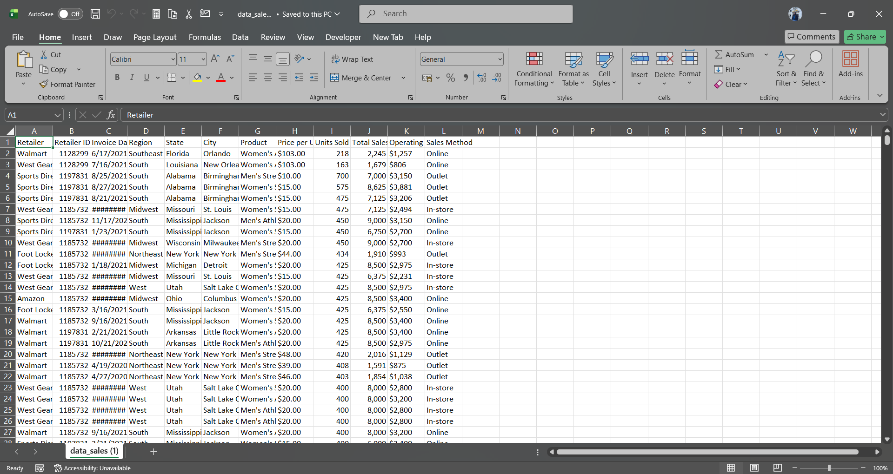

Slide 7

TOOLS & TECHNIQUES USED
Tableau – Dashboard creation and visualization
CSV Dataset – Data source
Basic data cleaning techniques

Slide 8
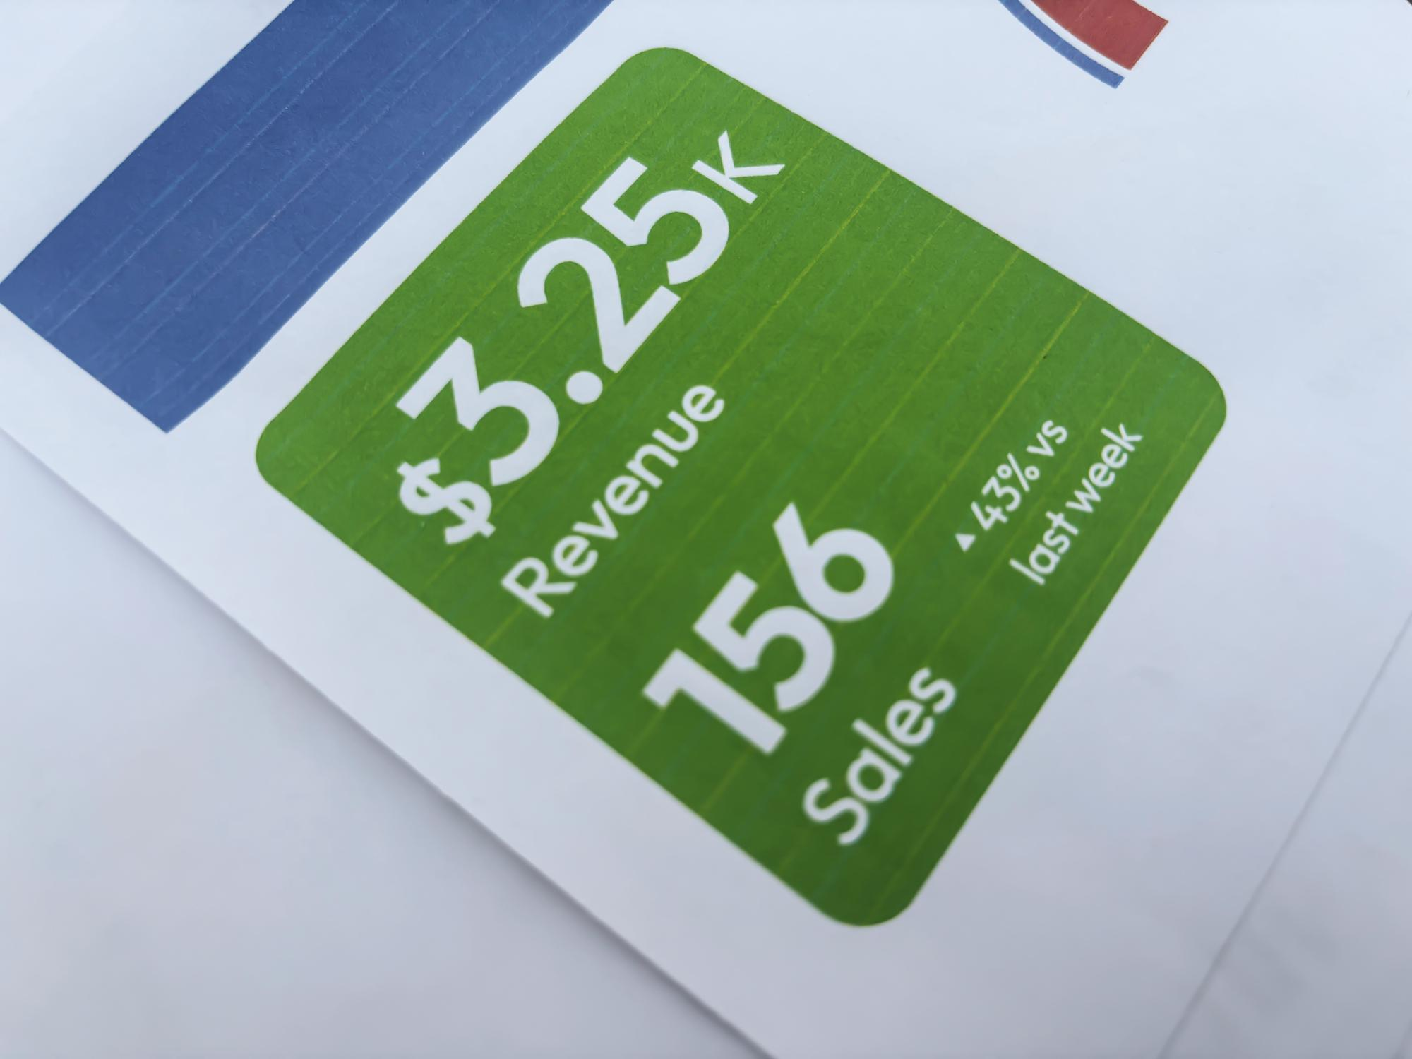
KEY PERFORMANCE INSIGHTS
Total Sales
Total Operating Profit
Average Price Per Unit
Total Units Sold
Operating Margin

Slide 9
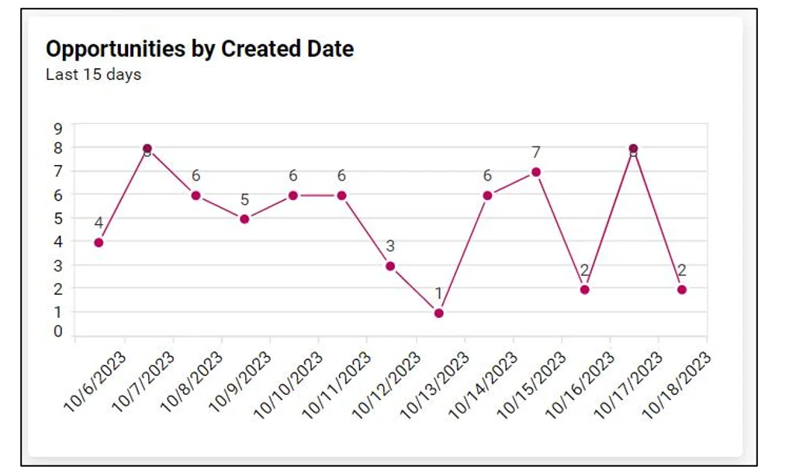
VISUALIZATION USED
Line Chart – Sales trend over time
Bar Chart – Sales by region and retailer
Pie / Donut Chart – Sales by sales method
KPI Cards – Summary of key metrics
Filters– Interactive analysis

Slide 10

DASHBOARD
An interactive dashboard developed using Tableau
Allows filtering by region, product, retailer, and sales method
Displays KPIs, trends, and comparative performance
Enables quick business insights through visual analysis

Slide 11
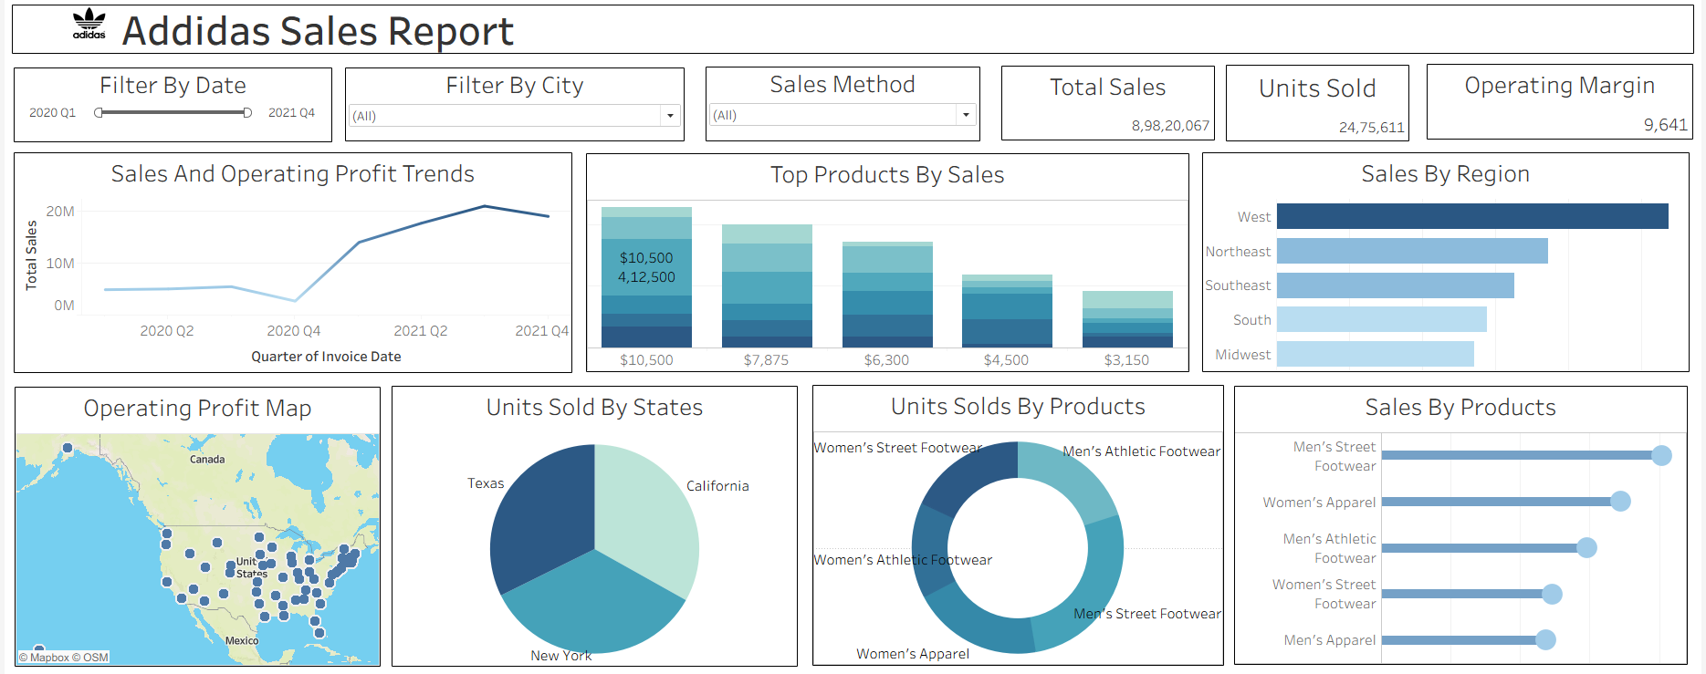

Slide 12
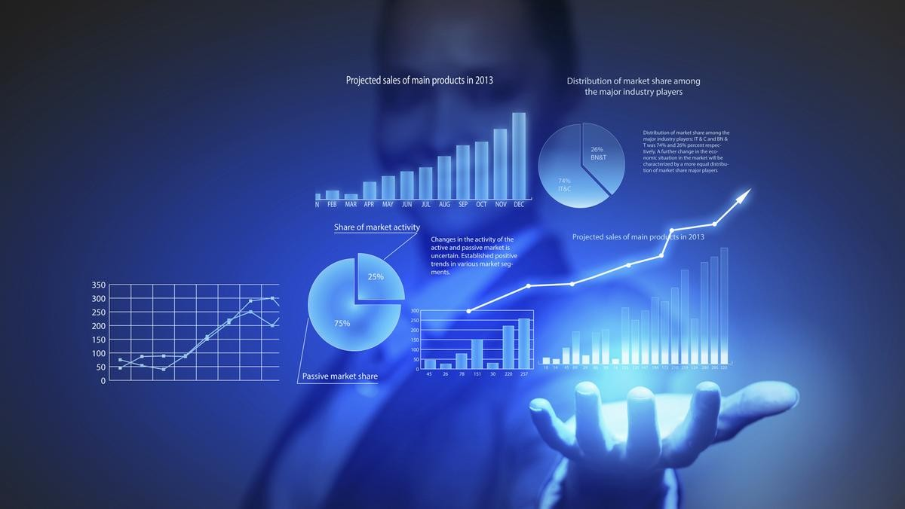
KEY INSIGHTS
Certain regions contribute significantly higher sales and profit
Online and outlet sales methods show strong performance
Some products have high sales volume but lower profit margins
Clear seasonal trends are observed in sales performance

Slide 13

BUSINESS BENFITS
Helps management understand sales distribution
Supports data-driven decision making
Identifies areas for revenue growth
Improves performance monitoring

Slide 14

FUTURE SCOPE
Integration of real-time sales data
Sales forecasting using predictive models
Customer behavior and demand analysis

Slide 15

REFERENCES
Kaggle – Adidas Sales Dataset
Tableau Official Documentation
IEEE Explore

Slide 16

CONCLUSION
This project successfully analyzed Adidas sales data using Tableau to extract meaningful business insights.
The analysis helped in understanding sales trends across different regions, products, and sales methods.
Key performance indicators such as total sales, operating profit, and units sold provided a clear view of overall business performance.
Interactive visual analysis made it easier to identify high-performing regions and profitable products.
The dashboard supports data-driven decision making by simplifying complex sales data into clear insights.
Overall, the project demonstrates how data visualization plays a vital role in improving retail sales analysis and strategic planning.

Slide 17


